Slide 1

UNIVERSITY INSTITUTE OF ENGINEERING
COMPUTER SCIENCE ENGINEERING
Bachelor of Engineering (Computer Science & Engineering)
Subject Name: Big Data Analytics
Subject Code: 20CST-471
Introduction to HDFS
Mapped with CO3
Prepared By:
Er. Ankita Sharma
DISCOVER . LEARN . EMPOWER

Slide 2
Hadoop Distributed File System (HDFS),
The Hadoop Distributed File System (HDFS) is a fundamental component of the Apache Hadoop framework, designed for distributed storage and processing of large-scale datasets. HDFS is inspired by the Google File System (GFS) and serves as the primary storage system for Hadoop applications.
HDFS divides large files into smaller blocks (typically 128 MB or 256 MB) and distributes these blocks across multiple nodes in a Hadoop cluster. Each block is stored on a separate DataNode.

Slide 3
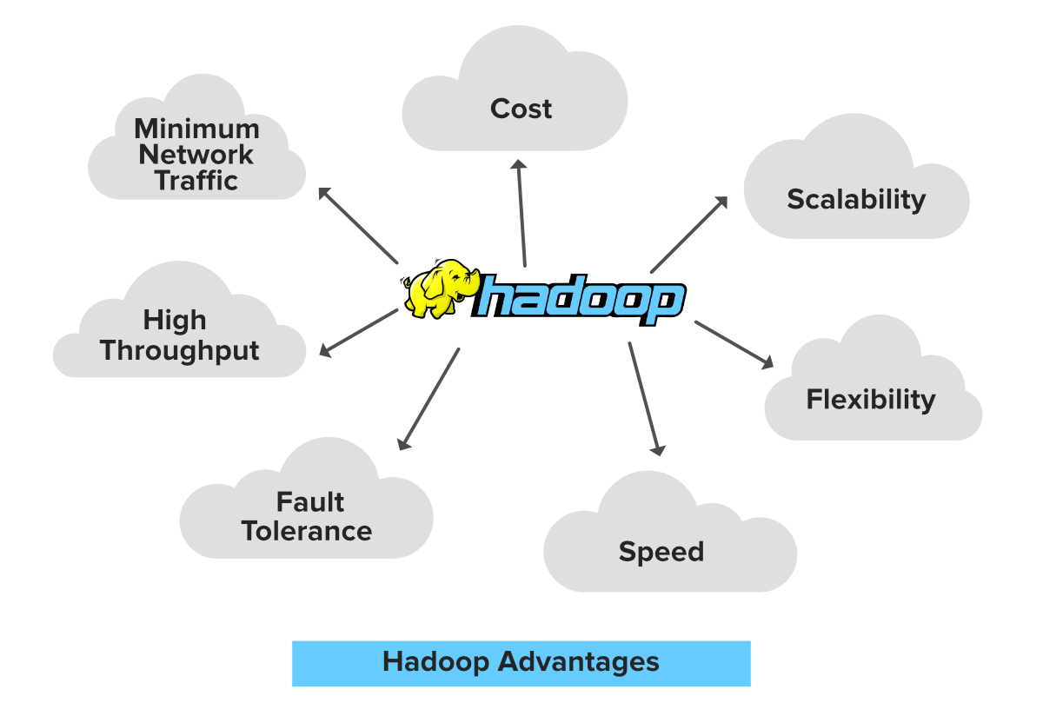
To ensure fault tolerance, HDFS replicates each data block multiple times across different nodes. The default replication factor is typically set to three, meaning that each block has three copies stored on different nodes. If a node or block becomes unavailable, the system can still access the data from the replicated copies.

Slide 4
Master-Slave Architecture:
HDFS follows a master-slave architecture with two main components:
NameNode: The master server that manages the metadata, including the namespace, file-to-block mapping, and the location of data blocks.
DataNodes: The slave nodes that store the actual data blocks. They periodically send heartbeat signals to the NameNode to confirm their availability.

Slide 5
Write Once, Read Many (WORM):
HDFS is optimized for batch processing and follows a Write Once, Read Many model. Once data is written to HDFS, it is typically not updated. New data is appended to existing files, and the original data remains unchanged.
Scalability:
HDFS is designed to scale horizontally by adding more commodity hardware to the cluster. This enables organizations to expand their storage capacity and processing power as their data grows.

Slide 6
Operations in HDFS:
Read and Write Operations:
Users can read and write data to HDFS using standard file system operations. HDFS supports both random access and sequential access patterns.
Replication Management:
The Name Node manages the replication factor of data blocks. It monitors the health of Data Nodes and initiates replication of blocks if a node becomes unavailable.
Block Balancing:
HDFS periodically balances the distribution of data blocks across Data Nodes to ensure uniform data storage and optimal utilization of cluster resources.
Metadata Operations:
Metadata operations, such as creating, deleting, and renaming files or directories, are managed by the Name Node.

